Slide 1
Federal Executive Webcast Series
Driving High-Performing Organizations
Kevin R. Cooke, Jr.
HUD Principal Deputy CIO
March 23, 2017

Slide 2
Definition of a High Performance Organization
“A High Performance Organization is an organization that achieves financial and non-financial results that are exceedingly better than those of its peer group over a period of time of five years or more, by focusing in a disciplined way on that which really matters to the organization.” André de Waal – HPO Center
https://www.hpocenter.com/hpo-framework

Slide 3
Success Factors of High Performance Organizations
The HPO Framework* describes five factors of high performance:
Quality of Management
Openness and Action Orientation
Long-Term Orientation
Continuous Improvement and Renewal
Quality of Employees
* What Makes a High Performance Organization—Five Validated Factors of Competitive Advantage That Apply Worldwide by Andre De Waal, 2007.

Slide 4
Quality of Management
Has integrity and inspires trust—models the behavior they want the organization to demonstrate
Demonstrates fast, confident, and effective decision making
Focuses on results and coaches members on how to achieve better results
Holds individuals responsible for their results and is decisive with regard to non-performers

Slide 5
How Quality of Management Applies in a Federal Organization
Communication is Key—Be direct and transparent with employees, customers, and leadership
Streamline and focus approval processes to speed decision making
Measure and communicate results
Document essential activity and outcomes in annual performance plans

Slide 6
Openness and Action Orientation
Engages in a dialogue with employees
Spends time on communication, knowledge exchange, and learning
Involves members in important processes
Allows employees to make mistakes
Welcomes change
Is performance driven

Slide 7
How Openness and Action Orientation Applies in a Federal Organization
Employee engagement efforts
Use of employee-led improvement teams
Delegation of authority to the lowest appropriate level
Assessing performance outcomes

Slide 8
Long-Term Orientation
Maintains good, long-term relationships with all stakeholders
Customer service focused
Stable, long-term management
Promotes from within the organization

Slide 9
How Long-Term Orientation Applies in a Federal Organization
Importance of career leader and staff positions
Succession planning
Use of Customer Relationship Coordinators

Slide 10
Continuous Improvement and Renewal
Has a strategy that sets it clearly apart
Processes are continuously improved, simplified, and aligned
Continuously innovates its core competencies, products, processes and services
Everything that matters to the organization’s performance is explicitly reported
Both financial and non-financial information is reported to organizational members

Slide 11
How Continuous Improvement and Renewal Applies in a Federal Organization
Strategic Planning as a roadmap rather than as “shelf-ware”
Focus on organization services that are unique and essential to the agency mission
Agile process improvement
Performance transparency with staff and customers

Slide 12
Quality of Employees
Management inspires employees to accomplish extraordinary results
Employees are trained to be resilient and flexible
Organization has a diverse and complementary workforce
Organization grows through partnerships with suppliers and/or customers

Slide 13
How Quality of Employees Applies in a Federal Organization
Reward high-performing staff with exciting projects and career development opportunities
Put attention and resources toward staff training and development programs
Leverage federal hiring authorities and programs
Participate in Presidential Management Fellows and other programs designed to attract young talent to Federal service

Slide 14
12 Principles That Guide High-Performance Organizations*
Ambition: Clear vision of what you want to achieve
Purpose: Clarity on why you need to excel
Measures: Comprehensive scorecards linking performance to vision
Standards: High standards fully embedded in the organization
Gap: Narrow performance distance between high and low performers
Decisions: Make decisions as close to the action as possible
*Skip Prichard Leadership Insights,
http://www.skipprichard.com/12-principles-that-guide-high-performance-organizations/

Slide 15
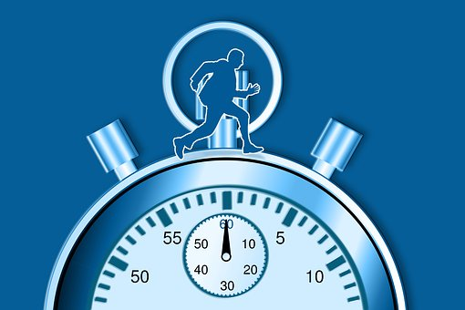
12 Principles That Guide High-Performance Organizations* (continued)
Code: Behavioral standards for organization members
Engagement: Strong connection across organization, staff, and stakeholders
Resilience: Capacity to maintain performance despite negative shocks
Feedback: organization focus on learning from performance
Teamwork: Recognition that high performance is a team endeavor
Improvement: Constant, organization-wide focus on improvement
*Skip Prichard Leadership Insights,
http://www.skipprichard.com/12-principles-that-guide-high-performance-organizations/

Slide 16
How Do We Get There From Here?—Driving the Change

Slide 17
Six Critical Success Factors* for Managing Change:
Vision/Strategic Planning—lack of vision leads to confusion in the workforce & with stakeholders
Urgency—lack of urgency leads to apathy and procrastination
Capabilities—lack of capability leads to anxiety for employees
Incentives—lack of incentives leads to resistance to change
Resources—lack of resources leads to frustration for those responsible for the change
Action Plan—lack of action plans leads to false starts and rework
*Becoming a High Performance Organization by Jeffrey Parks, December 21, 2015

